Slide 1
Time Series: UNIT 3
Live Session

Slide 2
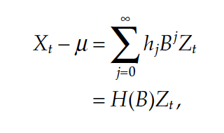
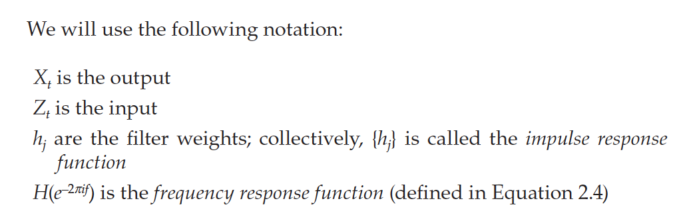
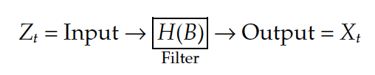
Linear Filters

Slide 3
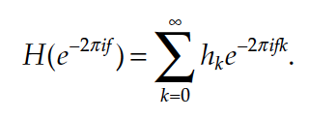
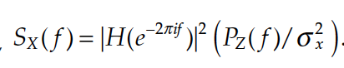
Spectral Density and Linear Filters
frequency response function
squared frequency response function

Slide 4
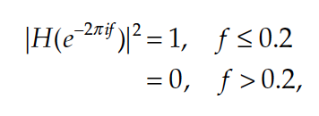
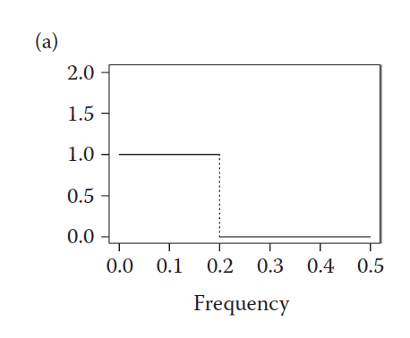
Ideal Frequency Response Function (Low Pass)

Slide 5
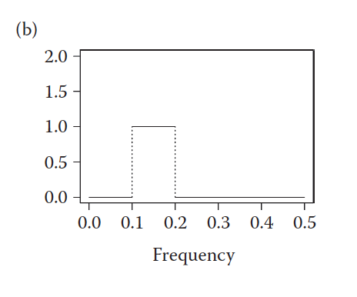
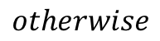
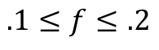
Ideal Frequency Response Function (Band Pass)
$$.1≤f≤.2$$
$$otherwise$$
butterworth.wge(x,order = 10, type = “band”, cutoff =c(.1, .2))

Slide 6
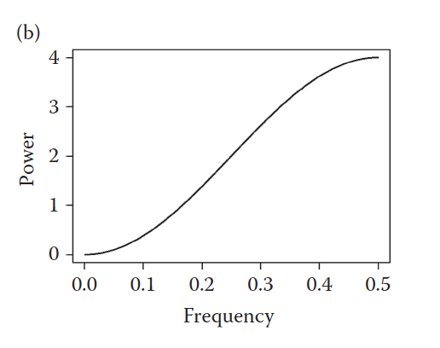
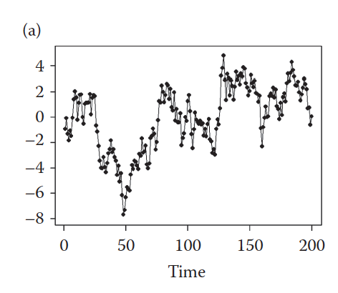
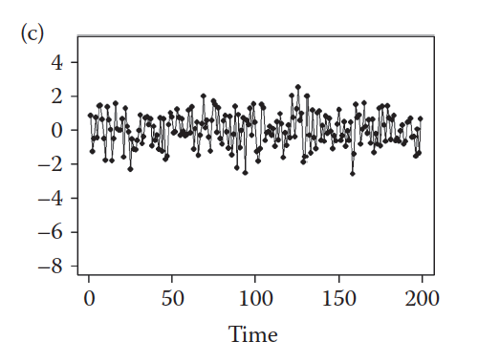
Frequency Response Function (High Pass) First Difference

Slide 7
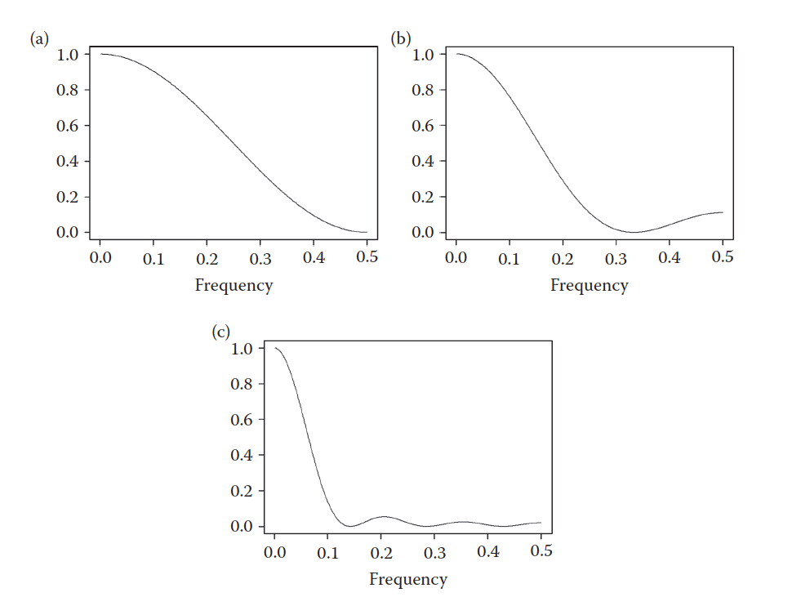
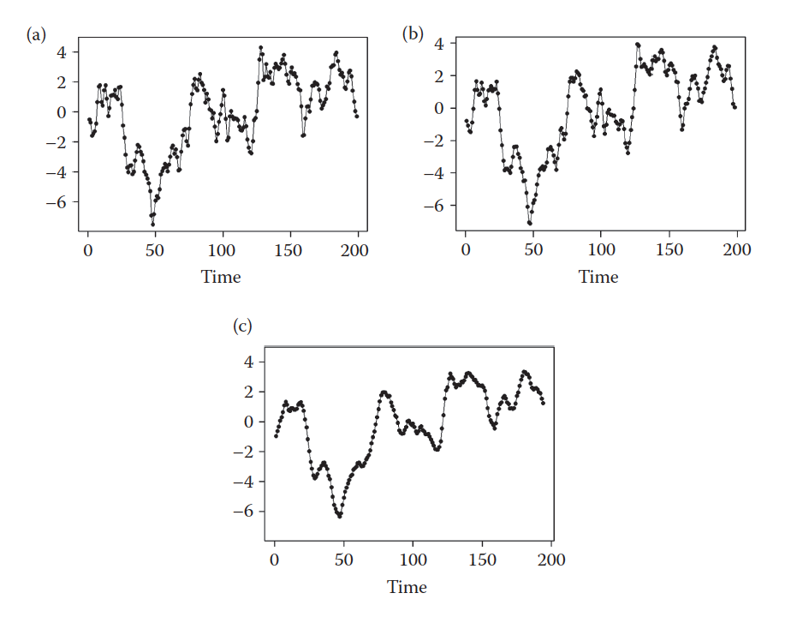
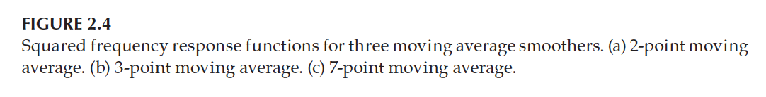
Frequency Response Function (Low Pass) Moving Average

Slide 8
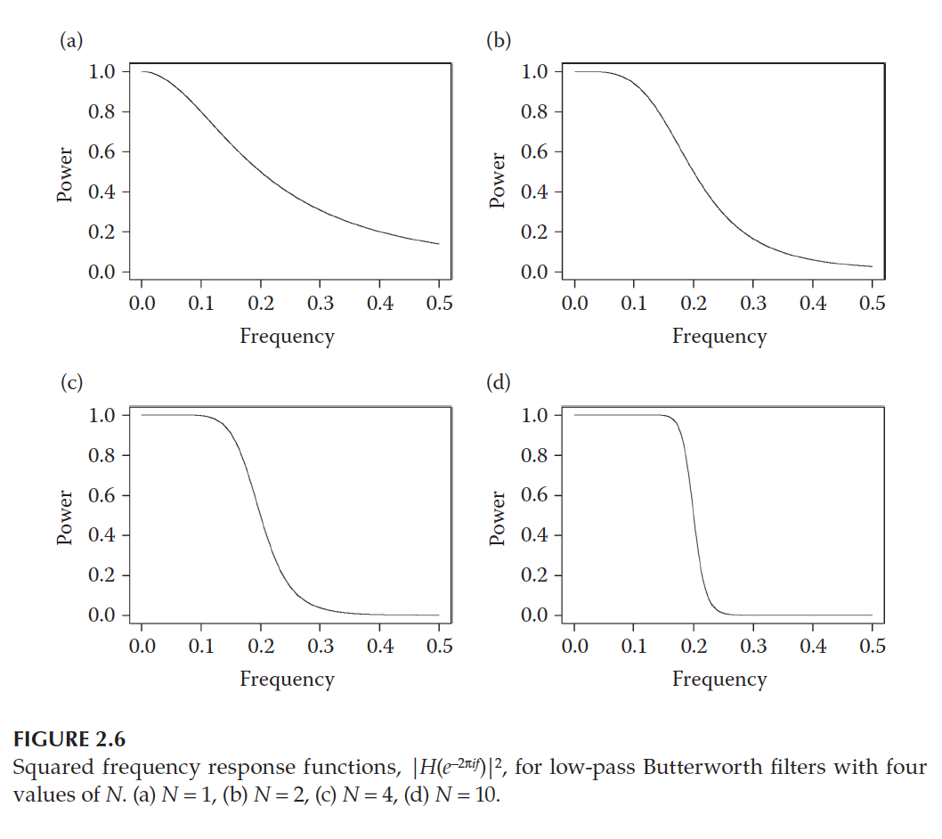
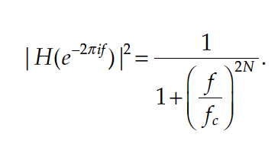
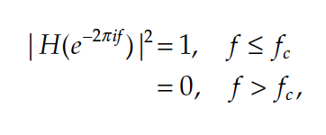
Butterworth Filters

Slide 9
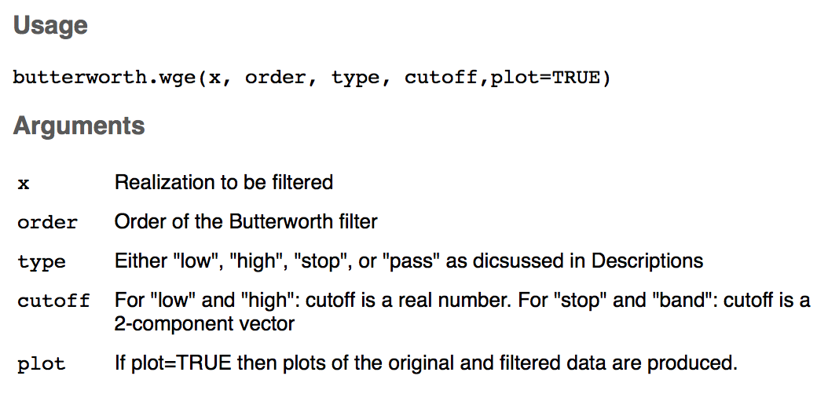
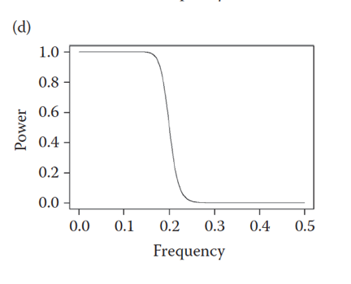
Butterworth Filter
butterworth.wge(x,order = 10, type = “low”, cutoff = .2)

Slide 10
BreakOut1
For Part 1 and Part 2
Plot the realization from each csv file.
Use Filters and other tools now at your disposal to try and diagnose the frequency or frequencies in the data.
Create a PowerPoint (Just one for the group.) for your reference and to possibly share with the class.

Slide 11
End Break Out 1

Slide 12
Break Out 2
Compare and check your answers for the worksheet. Make sure it all makes sense … we will be using these ideas extensively.
Move on to the two Questions (a-e for both).
If there is time… play with gen.arma.wge, plotts.sample.wge and plotts.true.wge

Slide 13
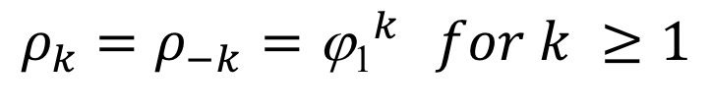

AR(1): X _{t} – φ ₁X_{t – 1} = a_{t}
Stationarity:
Stationary iff |$φ_{1}$| < 1
Autocorrelation:
$$ρ_{k}=ρ_{−k}={\text{j}\text{1}}^{k} for k ≥1$$
damped exponential
(oscillating if ϕ₁ <0)
Realizations look like:
ϕ₁ > 0 : Wandering
ϕ₁ < 0 : Oscillating
Spectrum:
has a peak at f = 0 (ϕ₁ > 0) or f = .5 (ϕ₁ < 0)

Slide 14
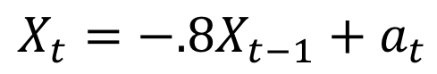
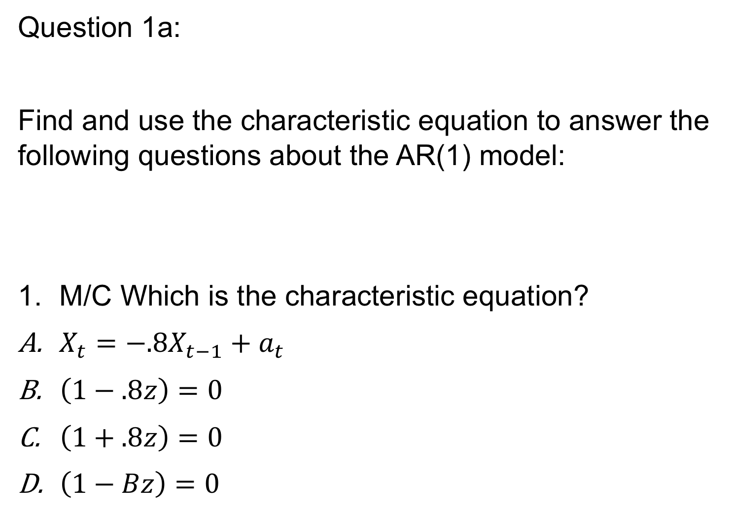
Question 1a:
Find and use the characteristic equation to answer the following questions about the AR(1) model:
M/C Which is the characteristic equation?
$X_{t}=−.8X_{t−1}+a_{t}$
$\left(1−.8z\right)=0$
$\left(1+.8z\right)=0$
$\left(1−Bz\right)=0$
$$X_{t}=−.8X_{t−1}+a_{t}$$

Slide 15
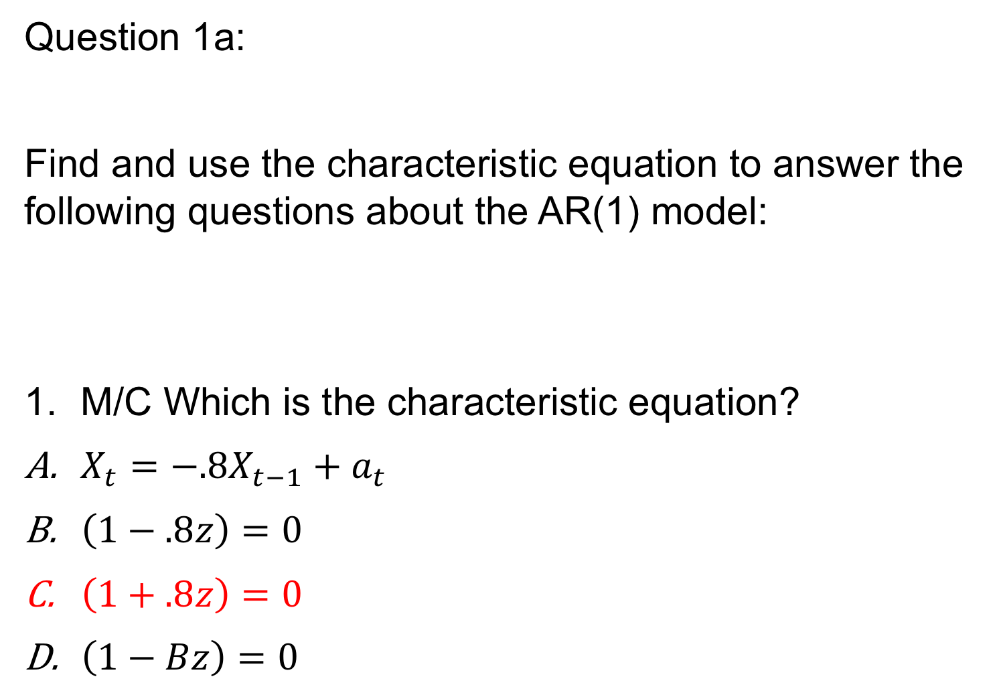
Question 1a:
Find and use the characteristic equation to answer the following questions about the AR(1) model:
M/C Which is the characteristic equation?
$X_{t}=−.8X_{t−1}+a_{t}$
$\left(1−.8z\right)=0$
$\left(1+.8z\right)=0$
$\left(1−Bz\right)=0$
$$X_{t}=−.8X_{t−1}+a_{t}$$

Slide 16
Question 1b:
Find and use the characteristic equation to answer the following questions about the AR(1) model:
What is the root of the equation. (Short Answer)
$$X_{t}=−.8X_{t−1}+a_{t}$$

Slide 17

Concept Check on AR(1) Characteristic Equation:
Find and use the characteristic equation to answer the following questions about the AR(1) model:
What is the root of the equation. (Short Answer)
Answer:
$$X_{t}=−.8X_{t−1}+a_{t}$$
$$\left(1+.8z\right)=0$$
$$.8z=−1$$
$$z= \frac{−1}{.8}$$
$$z=\text{−}\text{1.25}$$
$$\text{r}\text{ = −1.25}$$

Slide 18
Question 1c:
Find and use the characteristic equation to answer the following questions about the AR(1) model:
What is the inverse of the root: |r|⁻¹? (Short Answer).
$$X_{t}=−.8X_{t−1}+a_{t}$$

Slide 19
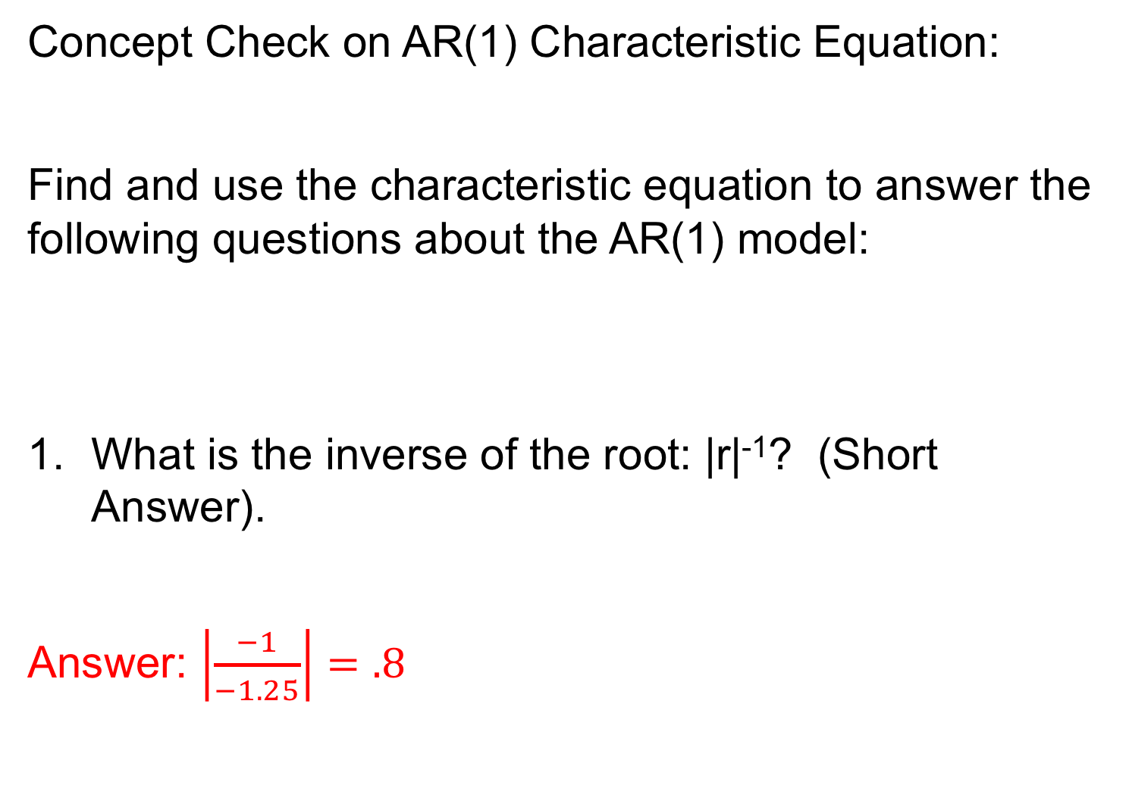
Concept Check on AR(1) Characteristic Equation:
Find and use the characteristic equation to answer the following questions about the AR(1) model:
What is the inverse of the root: |r|⁻¹? (Short Answer).
Answer: $\left|\frac{−1}{−1.25}\right|=.8$
$$X_{t}=−.8X_{t−1}+a_{t}$$

Slide 20
Question 1d:
Find and use the characteristic equation to answer the following questions about the AR(1) model:
M/C is the series stationary?
$$X_{t}=−.8X_{t−1}+a_{t}$$

Slide 21
Concept Check on AR(1) Characteristic Equation:
Find and use the characteristic equation to answer the following questions about the AR(1) model:
M/C is the series stationary?
Answer: The root of the characteristic equation is -1.25 which is outside the UNIT circle. For this reason the series is stationary.
$$X_{t}=−.8X_{t−1}+a_{t}$$

Slide 22
Question 1e:
Find and use the characteristic equation to answer the following questions about the AR(1) model:
Use tswge to create a realization from this model
$$X_{t}=−.8X_{t−1}+a_{t}$$

Slide 23
Question 1e:
Find and use the characteristic equation to answer the following questions about the AR(1) model:
Use tswge to create a realization from this model
$$X_{t}=−.8X_{t−1}+a_{t}$$
gen.arma.wge(100,phi = -.8)

Slide 24
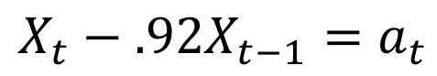
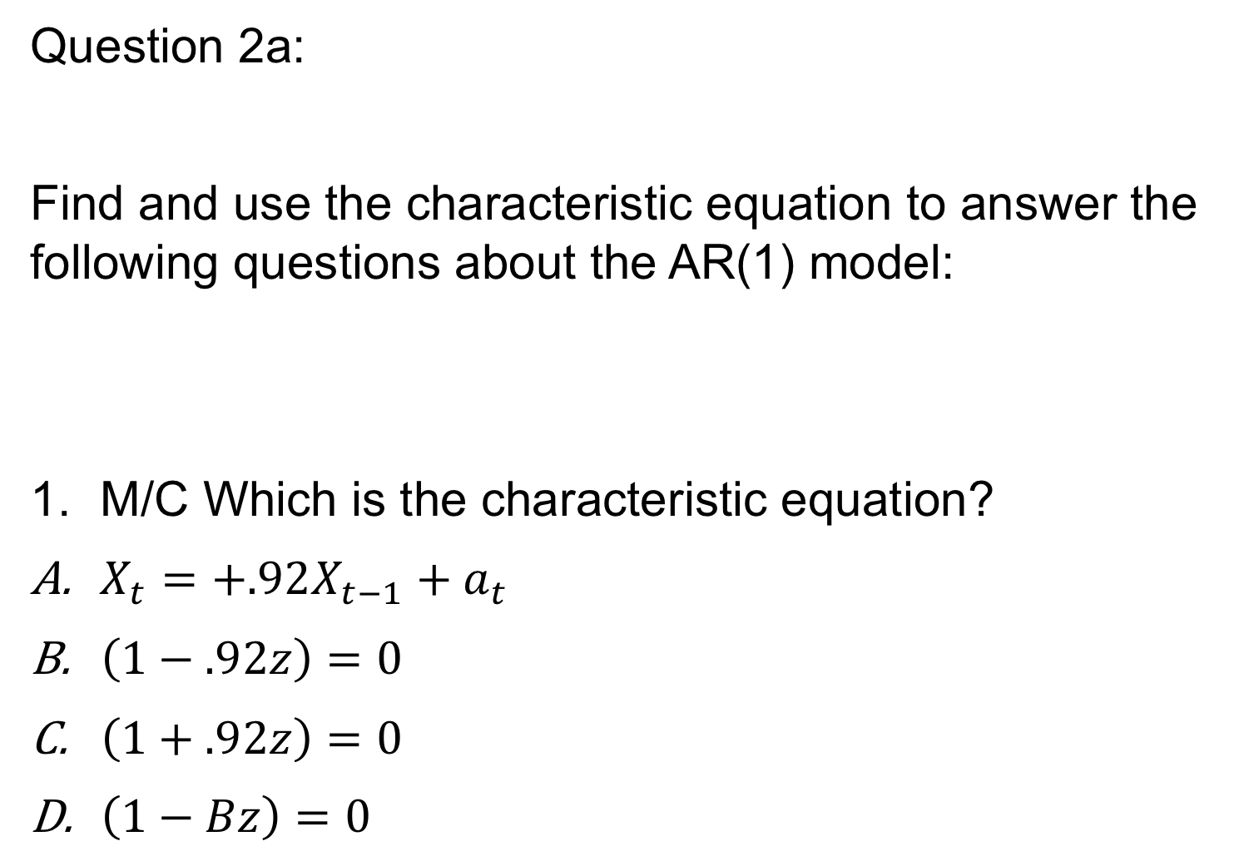
Question 2a:
Find and use the characteristic equation to answer the following questions about the AR(1) model:
M/C Which is the characteristic equation?
$X_{t}=+.92X_{t−1}+a_{t}$
$\left(1−.92z\right)=0$
$\left(1+.92z\right)=0$
$\left(1−Bz\right)=0$
$$X_{t}−.92X_{t−1}=a_{t}$$

Slide 25
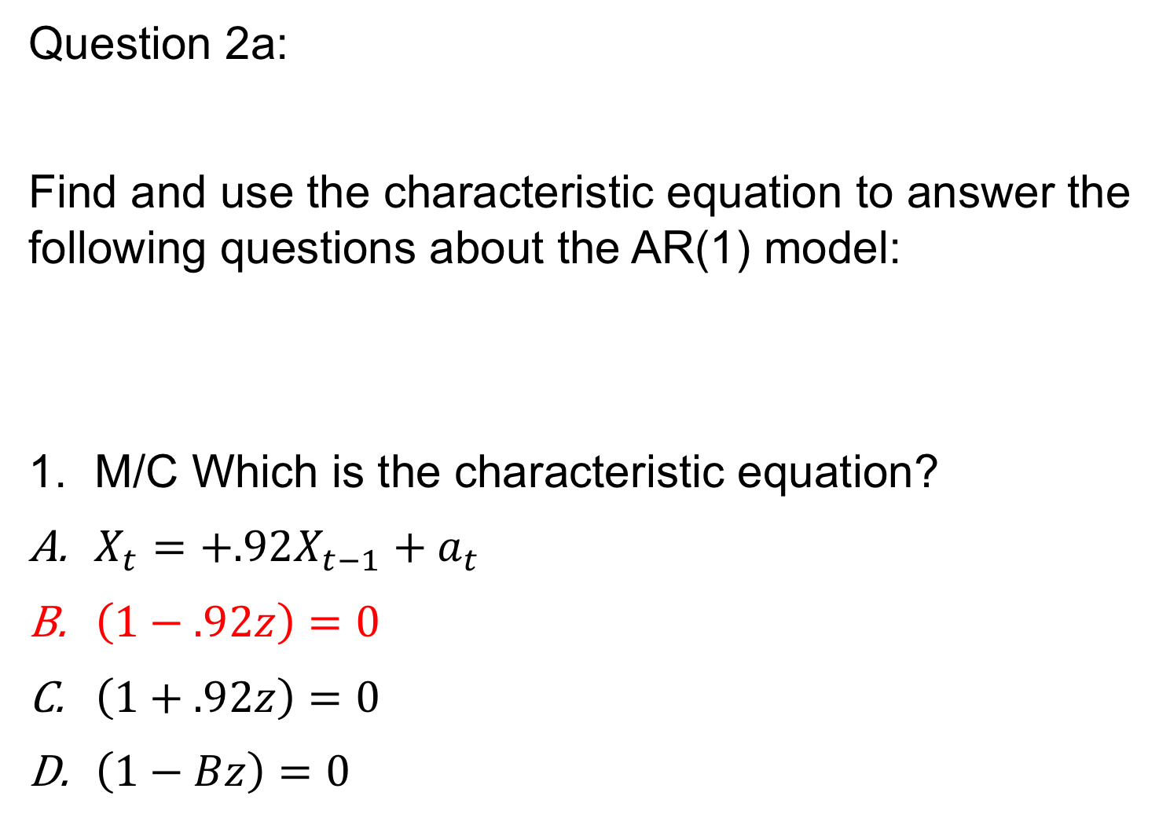
Question 2a:
Find and use the characteristic equation to answer the following questions about the AR(1) model:
M/C Which is the characteristic equation?
$X_{t}=+.92X_{t−1}+a_{t}$
$\left(1−.92z\right)=0$
$\left(1+.92z\right)=0$
$\left(1−Bz\right)=0$
$$X_{t}−.92X_{t−1}=a_{t}$$

Slide 26
Question 2b:
Find and use the characteristic equation to answer the following questions about the AR(1) model:
What is the root of the equation. (Short Answer)
$$X_{t}−.92X_{t−1}=a_{t}$$

Slide 27
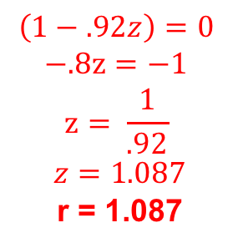
Question 2b:
Find and use the characteristic equation to answer the following questions about the AR(1) model:
What is the root of the equation. (Short Answer)
$$X_{t}−.92X_{t−1}=a_{t}$$
$$\left(1−.92z\right)=0$$
$$−.8z=−1$$
$$z= \frac{1}{.92}$$
$$z=\text{1.087}$$
$$\text{r}\text{ = 1.087}$$

Slide 28
Question 2c:
Find and use the characteristic equation to answer the following questions about the AR(1) model:
What is the inverse of the root: |r|⁻¹? (Short Answer).
$$X_{t}−.92X_{t−1}=a_{t}$$

Slide 29
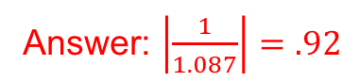
Question 2c:
Find and use the characteristic equation to answer the following questions about the AR(1) model:
What is the inverse of the root: |r|⁻¹? (Short Answer).
$$X_{t}−.92X_{t−1}=a_{t}$$
Answer: $\left|\frac{1}{1.087}\right|=.92$

Slide 30
Question 2d:
Find and use the characteristic equation to answer the following questions about the AR(1) model:
M/C is the series stationary?
$$X_{t}−.92X_{t−1}=a_{t}$$

Slide 31
Question 2d:
Find and use the characteristic equation to answer the following questions about the AR(1) model:
M/C is the series stationary?
$$X_{t}−.92X_{t−1}=a_{t}$$
Answer: The root of the characteristic equation is 1.087 which is outside the UNIT circle. For this reason the series is known to be stationary.

Slide 32
Question 2e:
Find and use the characteristic equation to answer the following questions about the AR(1) model:
Use tswge to create a realization from this model
$$X_{t}−.92X_{t−1}=a_{t}$$

Slide 33
Question 2e:
Find and use the characteristic equation to answer the following questions about the AR(1) model:
Use tswge to create a realization from this model
$$X_{t}−.92X_{t−1}=a_{t}$$
gen.arma.wge(100,phi = .92)

Slide 34
End Break Out 2

Slide 35
Break Out 3

Slide 36
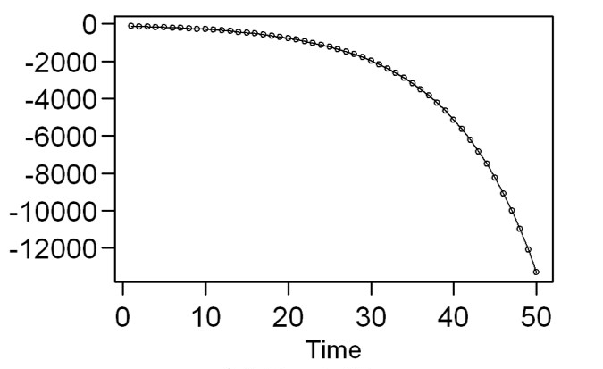
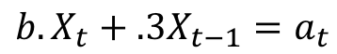
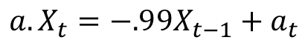
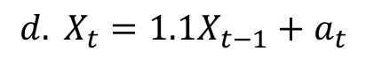
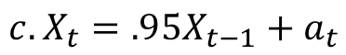
AR(1) Matching
1.
5.
Match the model with the realization or
or Spectral Density
2.
6.
$${a. X}_{t}=−.99X_{t−1}+a_{t}$$
3.
7.
$${b. X}_{t}+.3X_{t−1}=a_{t}$$
$${c. X}_{t}=.95X_{t−1}+a_{t}$$
4.
8.
$${d. X}_{t}=1.1X_{t−1}+a_{t}$$

Slide 37
AR(1) Matching
Match the model with the realization or
ACF or Spectral Density
5.
$${a. X}_{t}=−.99X_{t−1}+a_{t}$$
6.
$${b. X}_{t}+.3X_{t−1}=a_{t}$$
3.
$${c. X}_{t}=.95X_{t−1}+a_{t}$$
$${d. X}_{t}=1.1X_{t−1}+a_{t}$$
1.

Slide 38
End Breakout 3

